Slide 1
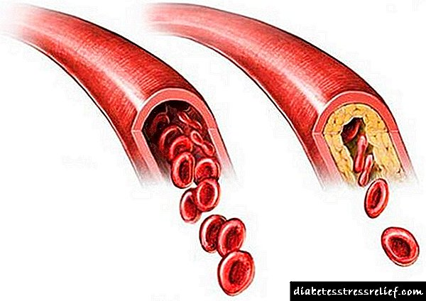
Non-stenotic Carotid Plaques And Ischemic Stroke: How Strong Is The Association?
Assist. Prof. Tatjana Bošković Matić
Neurology Clinic, University Clinical Center Kragujevac . Faculty of Medical Sciences University of Kragujevac

Slide 2
WE ALREADY KNOW:
That severe carotid artery stenosis is associated with higher risk of stroke
HOWEVER:
There is an increasing recognition of risk for stroke with non-stenotic carotid plaques (<50% stenosis)
Non-stenotic carotid plaques ipsilaterally to the brain hemisphere with ischemic lesions are present in patients with acute ischemic stroke or TIA

Slide 3
Š
Widely accepted system of etiological stroke classification requires at least 50% carotid artery lumen reduction in order to attribute stroke to carotid atherosclerotic disease.
Updated classifications allow for the possibility that carotid atherosclerotic plaque with less than 50% luminal reduction can be a potential source of thromboembolic stroke.

Slide 4
A substantial number of studies indicates that there is a risk of ipsilateral stroke or TIA in patients with non-stenotic carotid plaques
Study results:
The incidence of the first ipsilateral stroke or TIA was 1/100 persons
Recurrent stroke/TIA occurred in 3/100 patients and was increased to 5/100 individuals if there was also a bleeding inside the plaque
The risk of stenosis progression to the level of severe stenosis (> 50%) was 3/100
The Risk of Stroke and TIA in Nonstenotic Carotid Plaques: A Systematic Review and Meta-Analysis.
N Singh, M Marko, J M Ospel, M Goyal, M Almekhlafi, 2020 by American Journal of Neuroradiology

Slide 5
There is an increasing body of evidence of non-stenotic carotid plaques as potential sores in patients with ESUS

Slide 6
ESUS is a subtype of cryptogenic stroke
Non-lacunar stroke with patent blood vessels and normal heart rate
ESUS is responsible for 17% (9–25%) cases of ischemic stroke
Patients with ESUS are relatively younger and typically have mild strokes but with high rate of recurrence

Slide 7
Study published in the USA in 2019 include 138 patients with ESUS
Non-stenotic carotid plaques (<50% stenosis) were present in 54 of 138 (39.1%) ESUS patients
In patients with ESUS, non-stenotic carotid plaques were more often on the side of the ischemic stroke, indicating that these plaques could be a potential etiology of the stroke in patients in which the ischemic stroke in currently classified as ESUS

Slide 8
The size of the carotid plaque has been measure using the CT angiography (CTA)
It has been showed that large (≥3 mm diameter), non-stenotic (<50%) carotid plaques is detected mostly ipsilaterally, and not contralaterally in cryptogenic stroke cases
Nonstenotic carotid plaque on CT angiography in patients with cryptogenic stroke Jonathan M. Coutinho, MD, PhD,* Sheldon Derkatch, MD,* Alphonse R.J. Potvin, BSc, George Tomlinson, PhD, Tim-Rasmus Kiehl, MD, Frank L. Silver, MD, and Daniel M. Mandell, MD, PhDcorresponding author

Slide 9
Plauque with ≥5 mm thickness was present ipsilaterally of the side of the stroke in 11% of patients, and contralaterally to stroke in only 1% of patients
Plaque of ≥4 mm thickness was present ipsilaterally to the stroke in 19% of cases, and contralaterally in only 5% of patients
Plaque with ≥3 mm thickness was detected ipsilaterally to the side of the stroke in 35%, and contralaterally in 15% of cases
Plaque with ≥2 mm thickness showed the same prevalence ipsilateral (59%) and contralateral (58%) to the side of the stroke

Slide 10
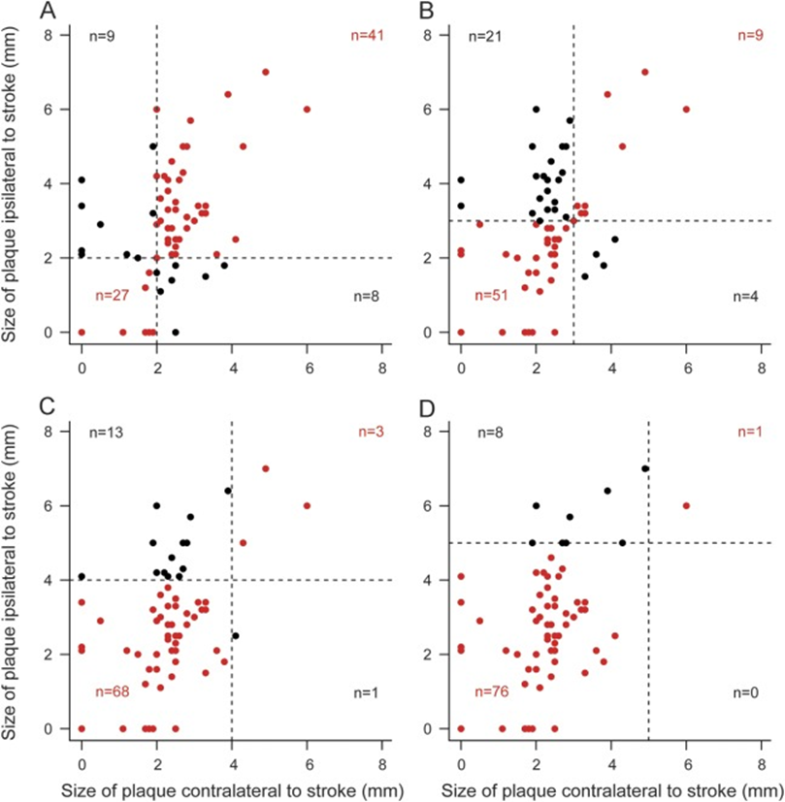
Besides mean carotid plaque thickness being larger ipsilaterally compared to contralaterally, also non-calcified component of the plaque thickness was larger ipsilaterally. Prevalence of plaque ulcerations was not different between ipsilateral and contralateral side

Slide 11
However, current evidence on non-stenotic carotid plaques as a potential source of emboli in patients with ESUS require confirmation in further research on this topic

Slide 12
THANK YOU FOR YOUR ATTENTION !!!

